Slide 1


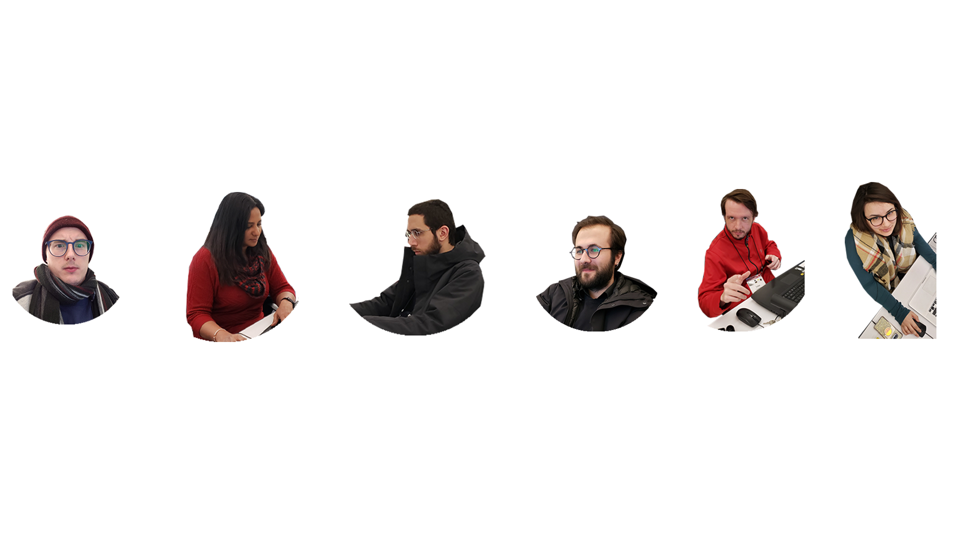
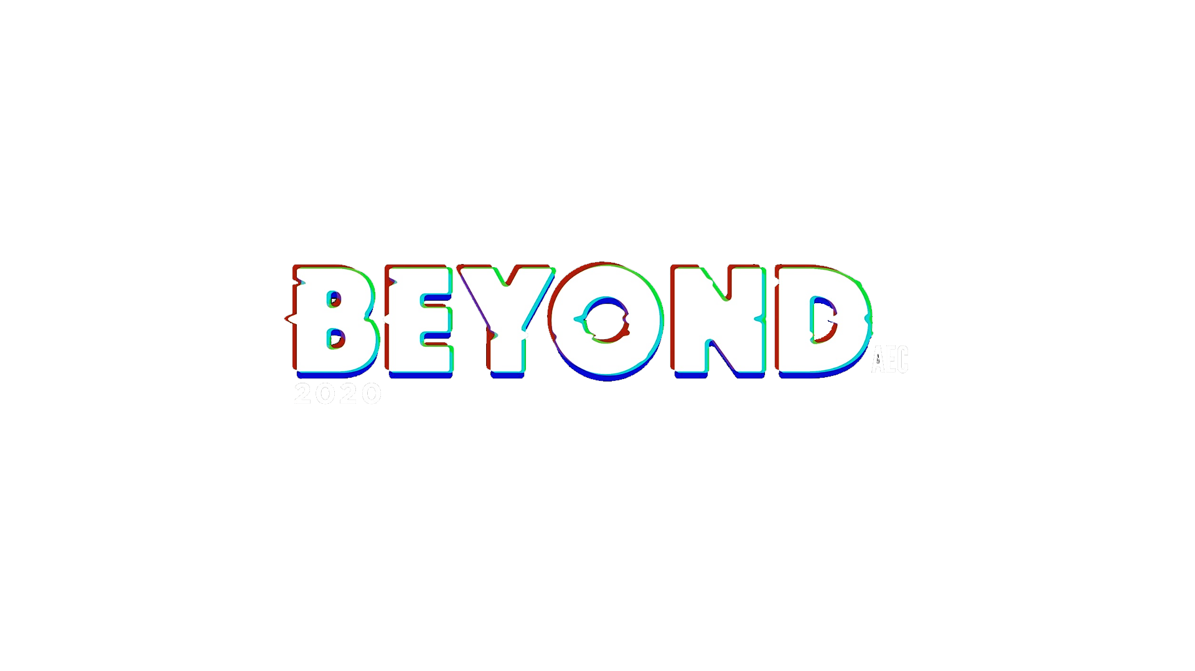
Luke Gehron (Payette)
Hasan Uretmen (Payette)
Justin Miller (Payette)
Liz Cooney (Payette)
Ahmad Tabbakh (Mancini Duffy)
Viveka Devadas (Autodesk)

Slide 2


Slide 3

Solar Glare
“Glare is a phenomenon caused by extremely bright light sources or by strong brightness contrasts in the visual field”
-Philips Lighting

Slide 4

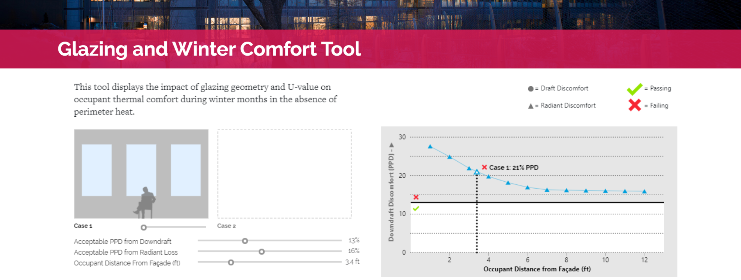
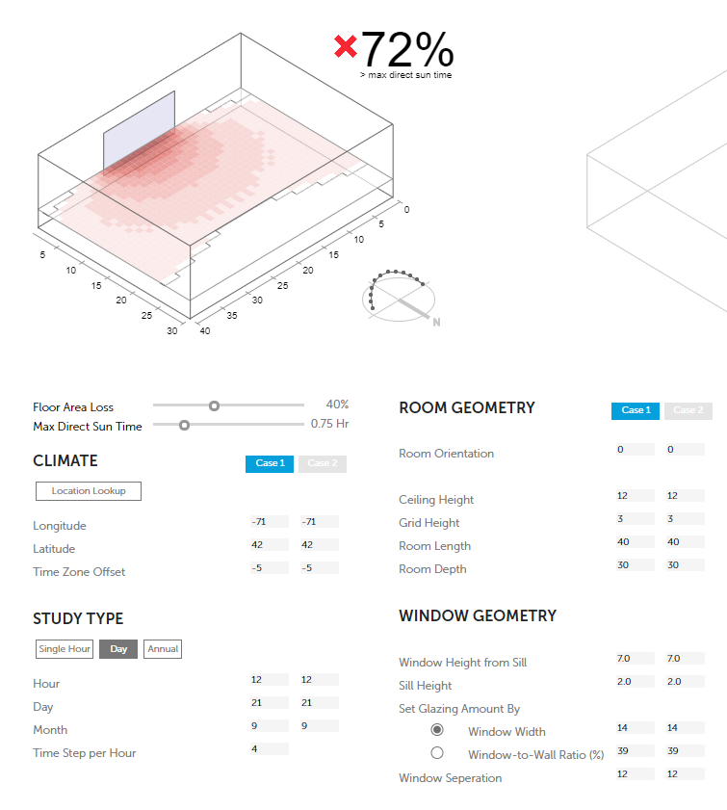
GLAZING AND WINTER COMFORT TOOL
SOLAR
COMFORT TOOL

Slide 5
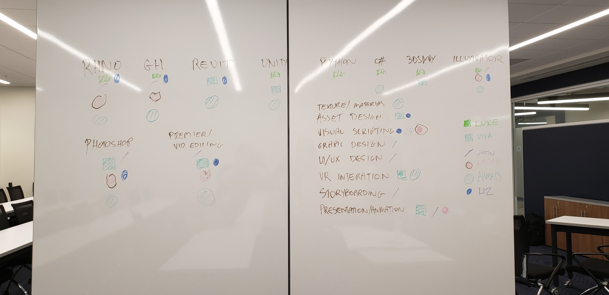
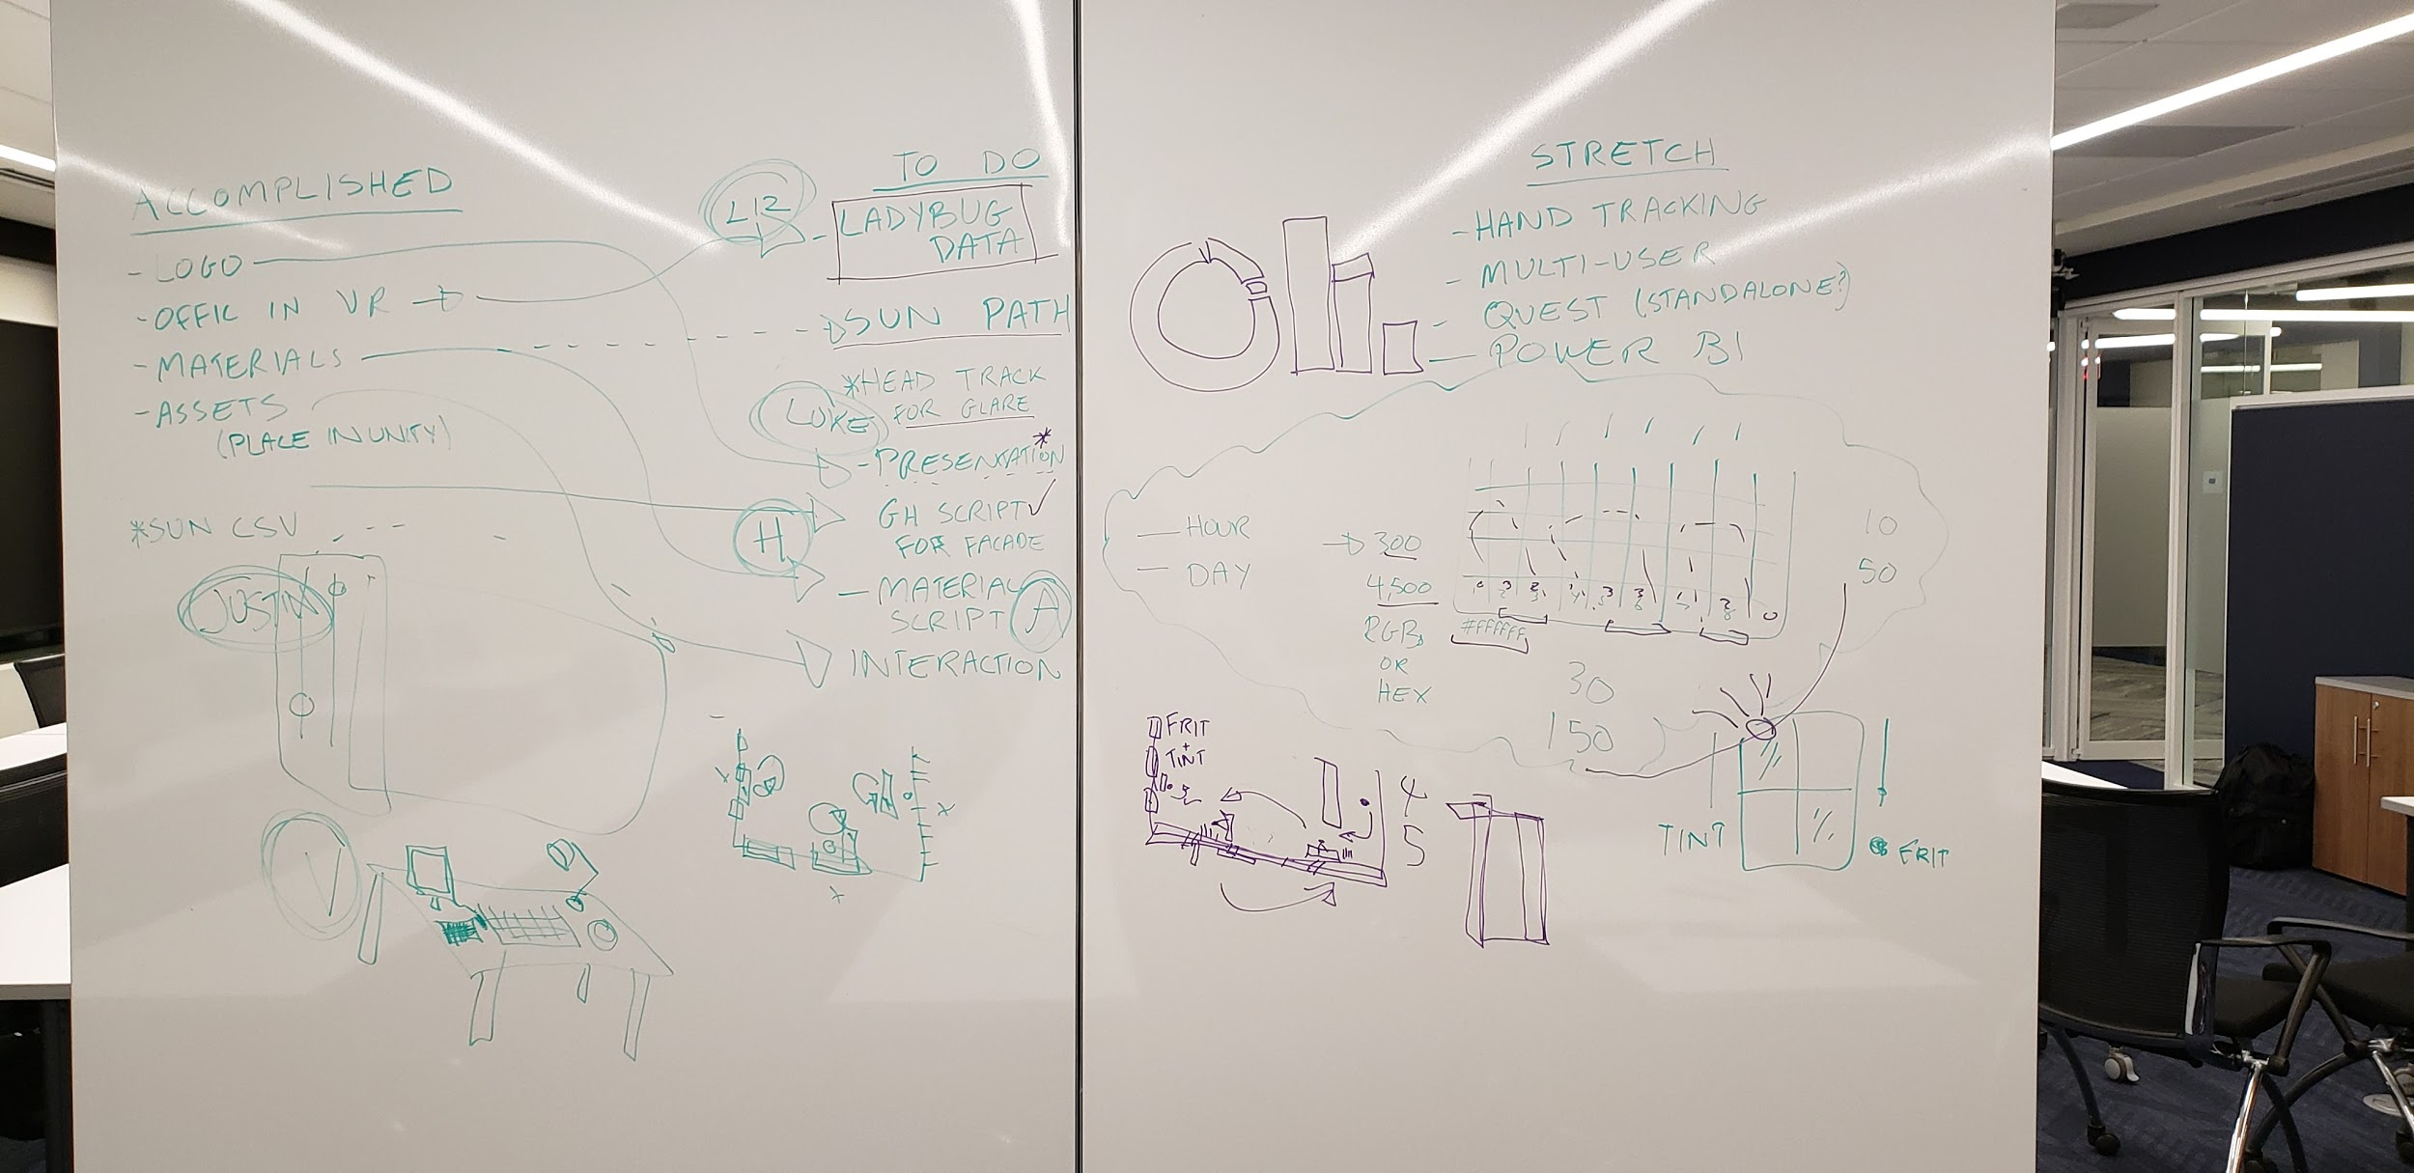
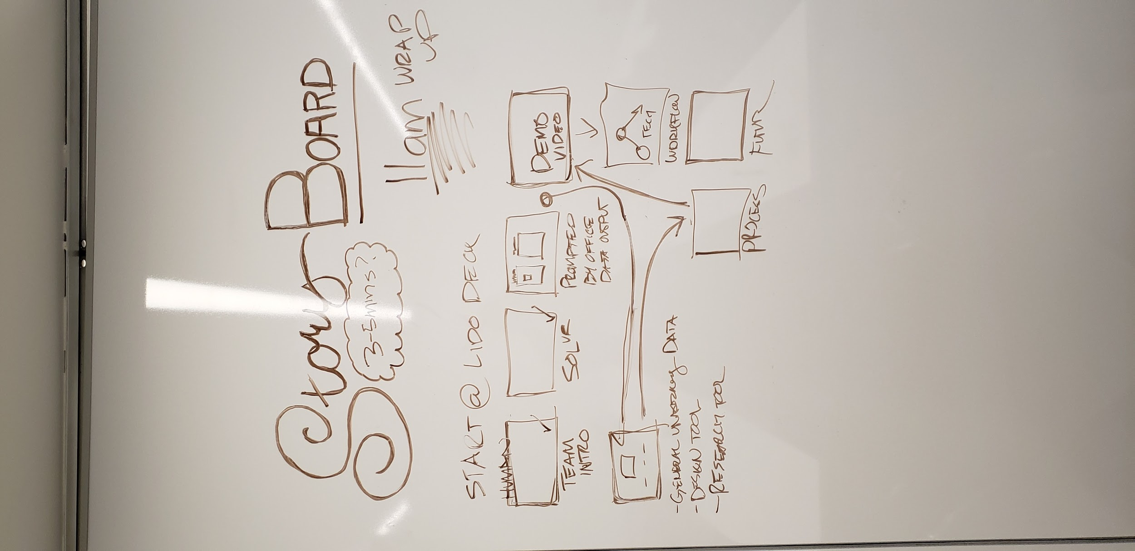
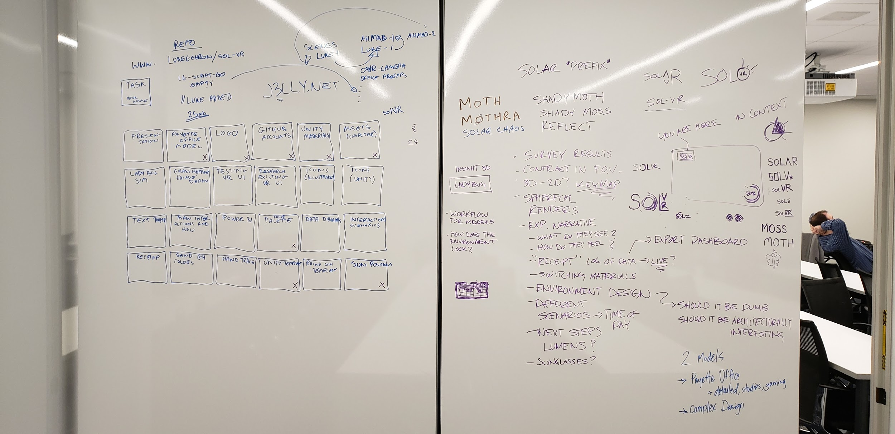
What can we achieve in the time we have?
What’s the skills set of the group?
How do we explain our concept?
What do people want to learn?
Who’s doing what task?
What should this tool do?

Slide 6
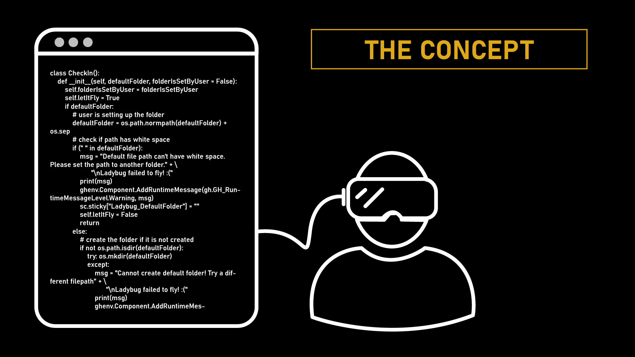




Slide 7
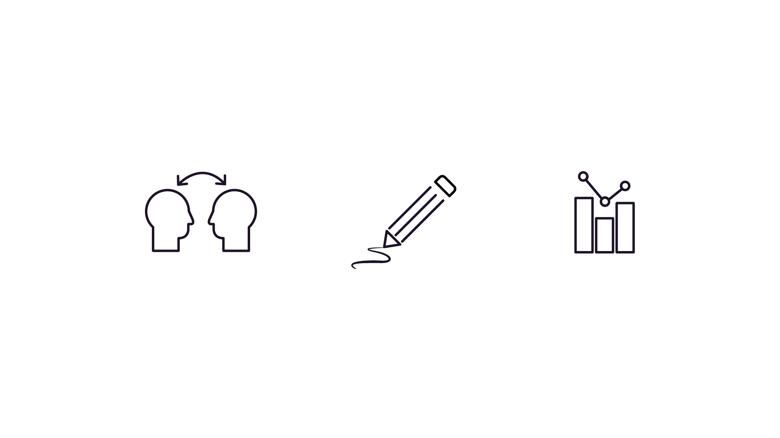
The Purpose of solVR
We envision three main functions of this VR tool: To help develop a general understanding for glare, to be used as a tool for design exploration, and to be used as a tool for research.
Demo >

Slide 8


Slide 9
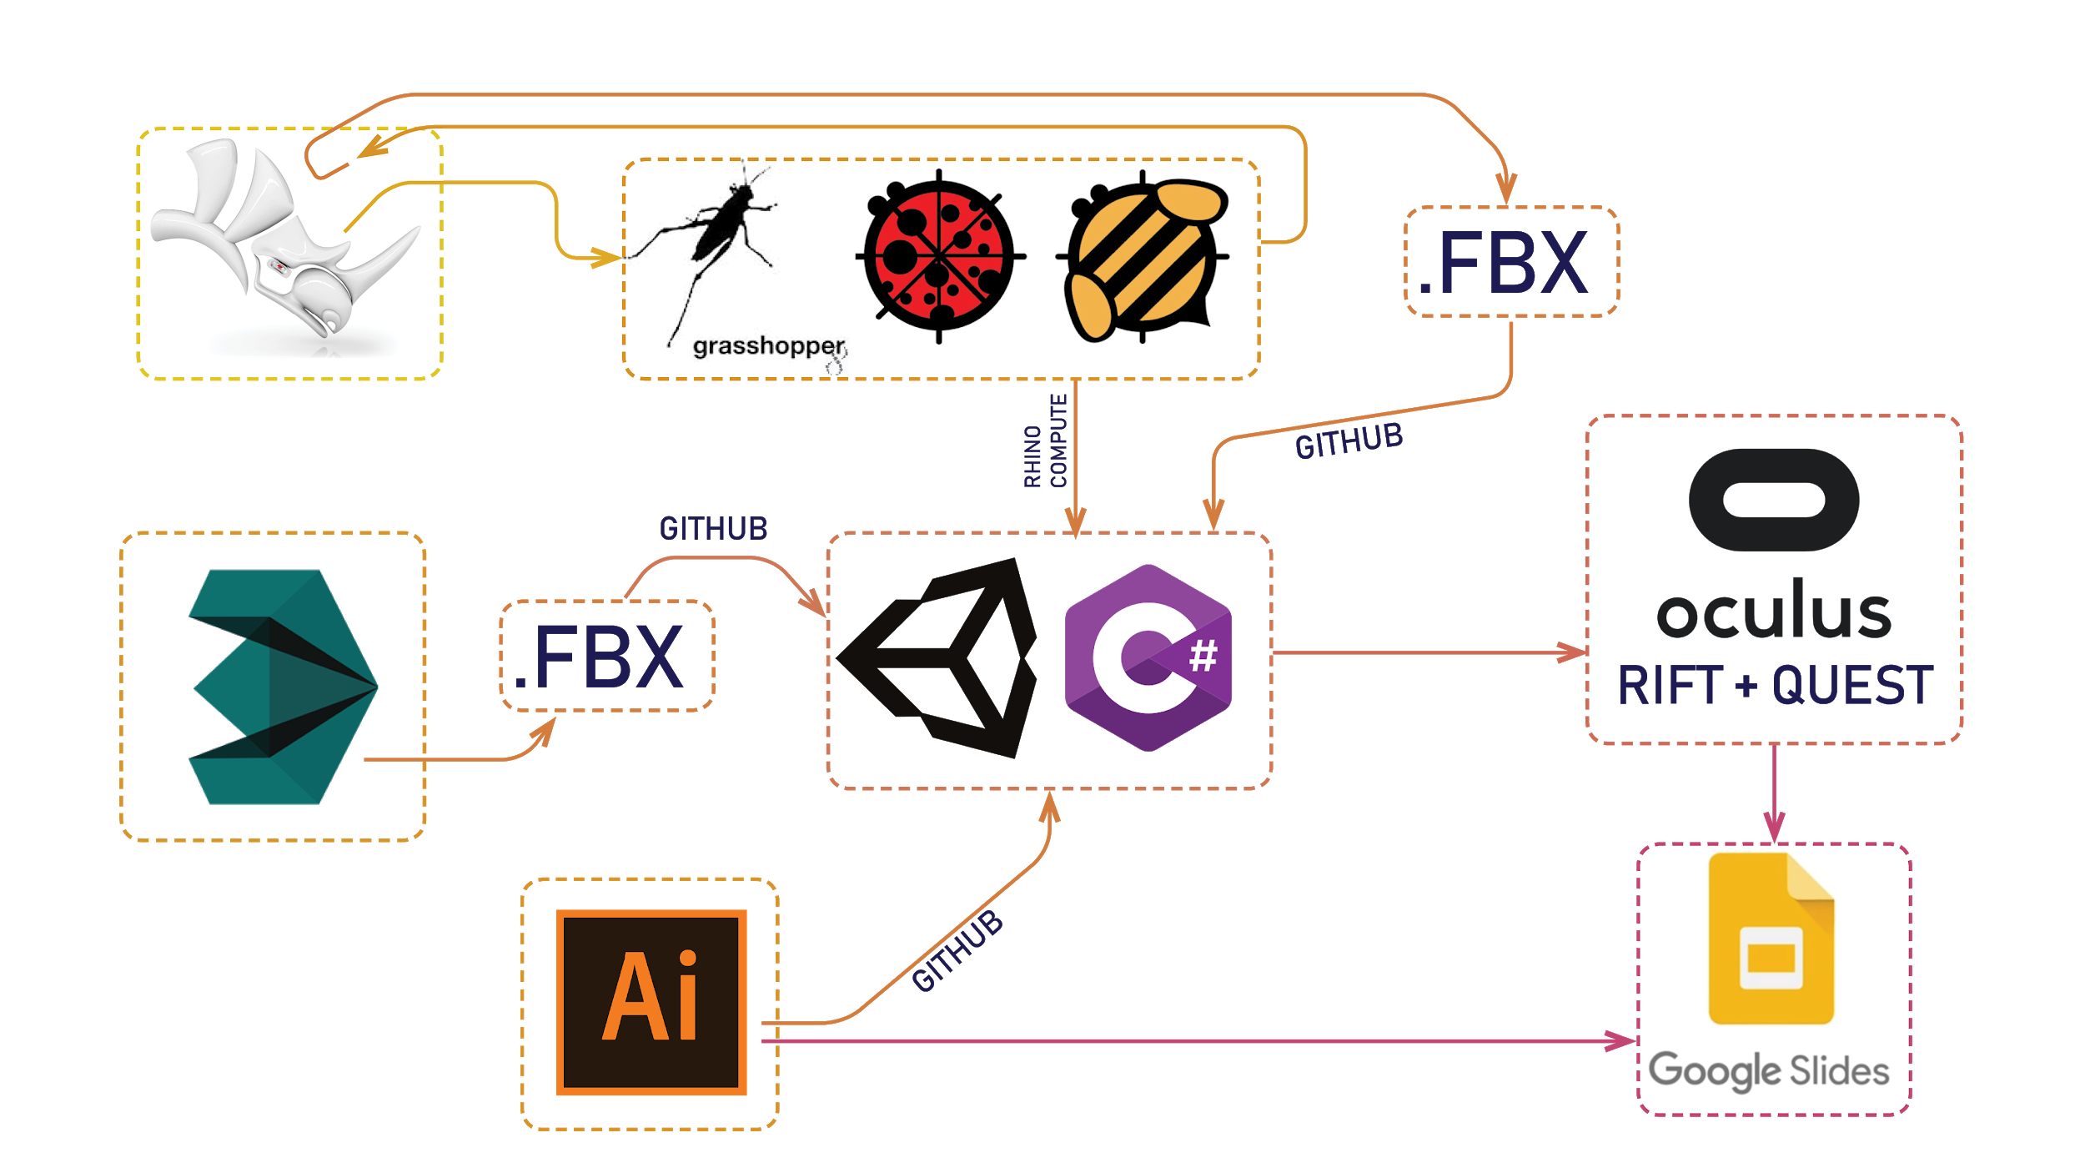

Slide 10
Next Steps
What we have developed are the ‘bones’ for more layers to be added. In future development we’d like to:
Continue to refine the tool and overall user experience
Incorporate Power BI into the VR user-interface to have a live dashboard that can also be printed at various moments in the exploration to have as a record for design discussion.
Develop a multi-user experience within the VR tool, with hand-tracking enabled to allow for more convenient movement and access of buttons in the virtual space
Expand the glare tool to register interior lighting glare along with the solar glare

Slide 11
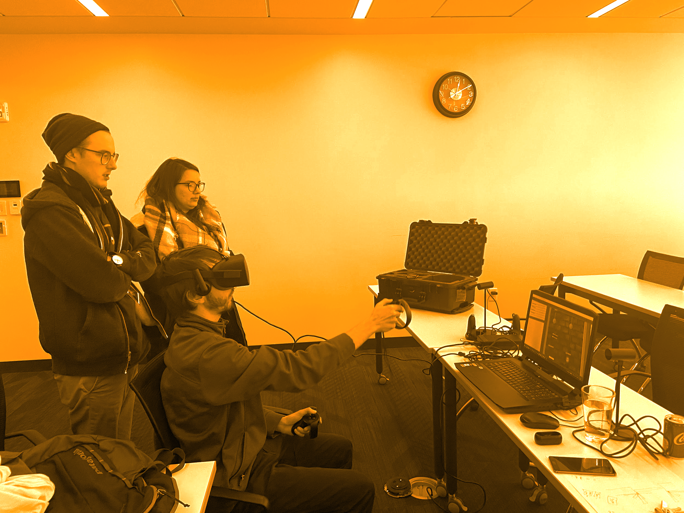

Thank You!

